Slide 1
350 MW Wind + Solar Hybrid Power Generation Project at Jhimpir, Thatta.
Directorate of Alternative Energy,
Government of Sindh

Slide 2
Project Details:
Technology: 250 MW Wind + 100 MW Solar
Location: Jhimpir, Thatta
Land Available: 2,291 Acres in Deh Kohistan 7/1 Tapo Jhampir, District Thatta. (Reserved)
Implementation Model: Business to Business (B2B)
Potential Buyer: Industrial Buyers in Karachi, Nooriabad, Hyderabad

Slide 3
Parameters
Expected Annual Generation: app. 940 GWh/Anum
App. 2.57 GWh/day
Project EPC Cost: Approx USD 365 Million or Rs.102.2 Billion @ Rs.280/USD
Equity: 100% GoS
Or 20% Equity & 80% debt (commercial banks or GoS)
Project Life: 25 Years
COD: 20 months (from the date of Financial Close)

Slide 4
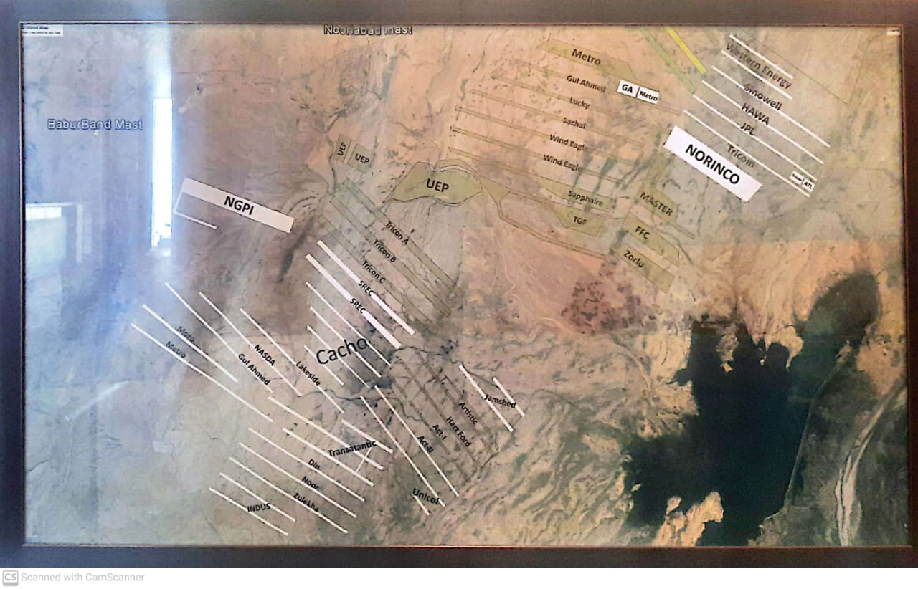
Project Proposed Land

Slide 5
Project Proposed Land
Project | Size | Latitude | Longitude
SREC 100 MW Wind Power Project | 2291 Acres | 25° 3'39.23"N | 67°46'16.84"E
 |  | 25° 3'31.32"N | 67°46'8.05"E
 |  | 25° 0'29.87“N | 67°49'49.93"E
 |  | 25° 0'20.08"N | 67°49'39.51"E
 |  | 25° 4'7.05"N | 67°46'43.74"E
 |  | 25° 4'0.06"N | 67°46'35.72"E
 |  | 25° 0'55.29"N | 67°50'21.20"E
 |  | 25° 0'48.11"N | 67°50'13.26"E

Slide 6
Project Proposed Land
Land was approved by Scrutiny Committee headed by Chairman LU Department dated 6.11.2015
Despite communication several times, allotment order yet to be issued by BoR.
Rates as approved by the Scrutiny Committee are:
Rs.3000 per acre per annum for 1st 10 Years = Rs. 68.73 Million
Rs.5000 per acre per annum for next 10 Years = Rs. 114.55 Million
Rs.8000 per acre per annum for further 10 Years = Rs. 183.28 Million
Total of Rs.366.56 Million to be paid for Land. However, initially an amount of Rs.67.73 million will be paid, remaining amount will be paid later in 2 installments i.e. at the start of each 10 years period.

Slide 7
Project Details: Wind
Wind Farm Capacity | 250 MW
Plant Capacity Factor | 35%
Estimated Output | App. 87.5 MW
Estimated Annual Generation | 766 GWh per Annum.
Turbines to be used | 36 Turbines each of 7 MW
Manufacturer (To be finalized after competitive bidding) | Goldwind or Gamesa or Vestas Denmark or CSIC China or HydroChina Corporation or Nordex Germany (subject to success in competitive bidding)
Wind EPC Cost | 1.20 Million USD/MW
Total Cost | 300 Million USD

Slide 8
Project Details: Solar
Solar Capacity | 100 MW
Plant Capacity Factor | 20%
Estimated Output | App. 20 MW
Estimated Annual Generation | 175.2 GWh
Solar PV Panels to be used | 142858 Panels each of 700 W Inverters 300 KW or 4 – 5 MW (Depends upon Design of Power Plant)
Manufacturer | Longi, JS, Canadian Solar, etc… To be finalized after competitive bidding
Soar PV EPC Cost | 0.65 Million USD/MW
Total EPC | 65 Million USD/MW

Slide 9
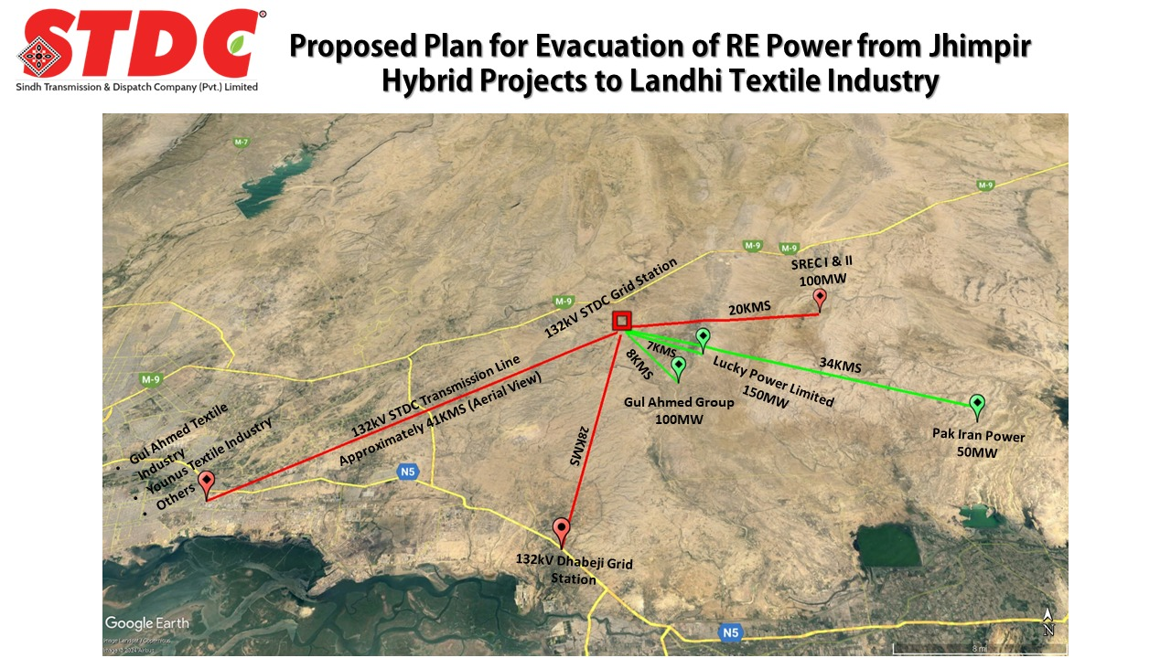
Project Details: Evacuation Plan by STDC

Slide 10
Project Details: Evacuation Plan by STDC
Transmission lines Capacity | 350 MW Evacuation
Total Project Cost | 19.865 Billion
Financing Structure | 20% Equity: 80% Debt
Return on Equity | 20%
Levelized Tariff for Wheeling over 25 Years | Rs. 5.1395

Slide 11
Project Details: Wind+Solar Hybrid
Plant Capacity | 350 MW
Estimated Annual Generation | 947.1 GWh
Total Project Cost | Rs. 368.17 Billion
Financing Structure | 20% Equity : 80% Debt
Project Life | 25 Years
Total Project Cost | USD 365 Million or Rs. 102.2 Billion @ Rs.280/USD
Levelized Tariff Generation | ~Rs.13.3/Unit
Levelized Tariff Transmission | 5.1395
Total Levelized Tariff of the Project | Rs.18.45/Unit

Slide 12
Hybrid Power System Solar PV – Wind - BESS
Solar PV and Wind Hybrid have time frames where both resources are available lesser than the required Power.
Both resources are intermittent and can create voltage stabilization and frequency drop issues
In order to improve the output profile of Solar & Wind Hybrid Power Plants, Battery Energy Storage Systems are added.
BESS charges energy during excess generation period and discharges as and when required to provide a stable power output profile

Slide 13
Following Cases are studied
Case 1
: 250MW Wind + 100MW Solar
02
01
03
Case 2
Case 3
250MW Wind + 100MW Solar + 100/300MWh BESS
300MW Wind + 150MW Solar + 30MW/150MWh BESS

Slide 14
Case 1 250MW Wind + 100MW Solar
Results Case 1 250MW Wind + 100MW Solar
Total Generation Output = 1138 MWh per annum
Capacity Factor = 52%
Transmission Evacuation Capacity is kept at 350MW
No. of hours during which the output is greater than 300MW is only 19 hours, No. of hours during which the output is greater than 200MW is 2370
Case 1is assumed as a single block
Larger BESS would be required to ensure more smooth continuous supply of energy levels

Slide 15
Case 2 250MW Wind + 100MW Solar + 100 / 300 MWh BESS
Results Case 2
Total Generation Output = 1136 MWh per annum
Capacity Factor = 51.6%
Transmission Evacuation Capacity is kept at 250MW to allow for charging of BESS above 250MW
No. of hours during which the output is greater than 200MW is 2424
Case 2 is assumed as a single block
This means with a 250MW/100MW Hybridization a 100/300MWh battery is enough to deliver the energy continuously for above 200MW for 2424 hour.
A further increase in installed capacity of Wind and Solar would be required to ensure continuous delivery of power above 250MW

Slide 16
Case 3 300MW Wind + 150MW Solar + 3* (50 / 100) MWh BESS
This case is to be developed in three blocks each of following size
(100MW Wind + 50MW Solar + 50MW/100MWh BESS) X 3
This will ensure a relatively smoother output and easier to manage
The transmission evacuation capacity can be governed by 100MW of wind- ( Total of 300MW)
The target is that each power plant shall deliver 100MW power continuously for longer period and 50MW stable output
Total Generation Output = 468.22 MWh per annum ( out of 470MWh)
Capacity Factor = 54% ( with 300MW evacuation capacity)
Transmission Evacuation Capacity is kept at 100MW to allow for charging of BESS above 100MW
No. of hours during which the output is greater than 50MW is 4242 which is 48.5% and greater than 80MW for 2549 hours

Slide 17
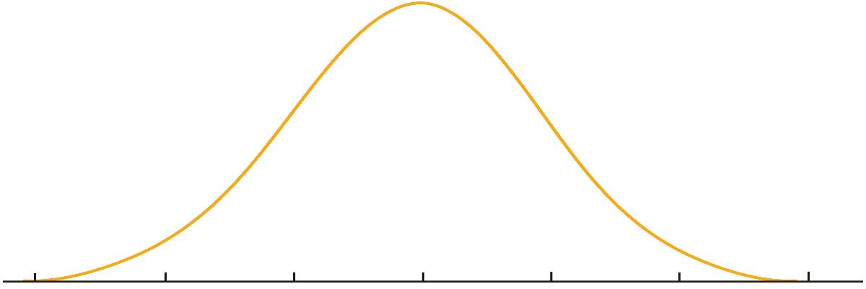
Pakistan – COMPARISON WITH SELECT COUNTRIES
Based on the trends observed in countries with a developed solar energy market, such as Germany and the USA, the solar adaptation process can be mapped along a curve with various stages based on the stage of solar adoption for end-consumers of solar energy.
Solar energy adoption cycle by country and introduction of net-metering
Note:
*The years represent the introduction of net-metering policy by the Government.
** The stages apply to companies that are the end-consumers of solar energy within the C&I segment.
Take-off point
2011
2005
2012
2000
2019
2014
2015
Adoption stage
Note: In Germany, the net-metering concept was not introduced until 2000. The initial growth was driven by other incentives and benefits such as subsidies and feed-in tariffs.

Slide 18
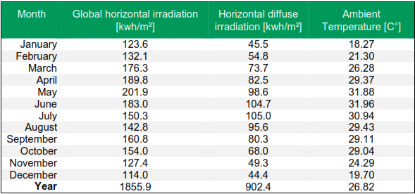
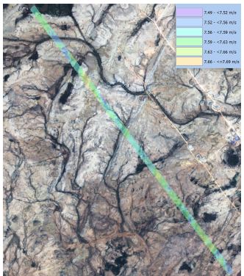
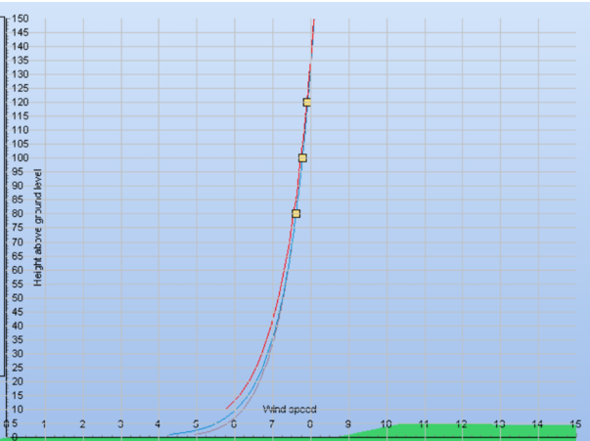
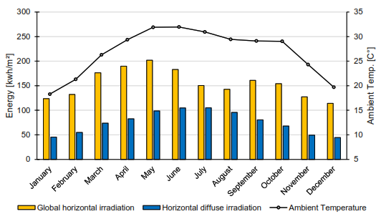
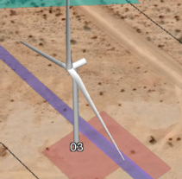
Hybrid – Wind + Solar
Resource Maps – Wind & Solar -Jhimpir
Details of Solar Resource
Details of Wind Resource
Details of Solar Resource

Slide 19
Simulation: Wind + Solar Hybrid (Winters)

Slide 20
Simulation: Wind + Solar Hybrid (Summers)

Slide 21
Generation – Each WTG Option

Slide 22
Project Feasibility Steps
Environmental Study
Logistics Study
Topographic Survey
Wind Project Feasibility
Geo Technical Study
Wind Resource Assessment
Geo Technical Study
Grid Interconnection
Done
< 90 Days
>90 Days

Slide 23
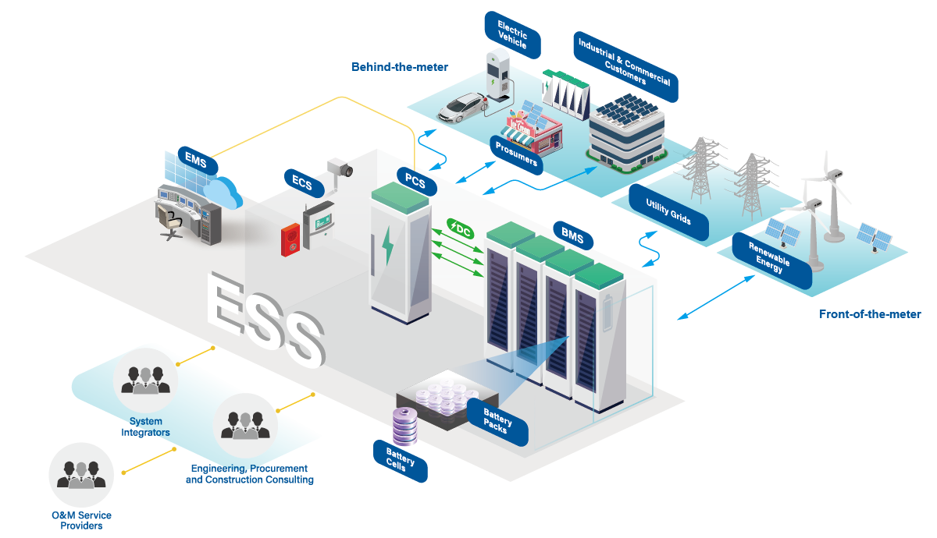
BESS System

Slide 24
Least Cost of Energy Solar PV – Wind - BESS
Case 3 Continued – Interconnection Arrangement
The Three blocks of Hybrid Power Plants shall be connected to the 132kV substation
The Power Capacity of the 132kV Substation should be 3x 300MVA step up transformer ( 33kV/132kV , 100MVA Transformers).
Each Hybrid Plant with BESS shall be connected to the independent transformer.
Triple circuit 132kV Transmission line shall evacuate the power with 100MW capacity each as shown in the layout earlier.
Area required for each block
Wind - 2300 Acre
PV – 50MW - 175Acres ( although as per configuration solar PV panels can be placed in same area as Wind Turbines)
BESS – 2 acre of land (2.5-3.5MWh size of each container –Total 30-40 containers)

Slide 25
Least Cost of Energy Solar PV – Wind - BESS
Case 3 Continued – Interconnection Arrangement
The estimated CAPEX cost of 100MW Wind Plant is USD 145million
The estimated CAPEX cost of 50MW Solar PV Plant is USD 23.6million USD
The estimated CAPEX cost of 50MW/100MWH BESS is USD 26.5million
Total estimated CAPEX cost per block is USD 195.1million
Grid Connection cost is estimated at USD 7 million
OPEX is estimated at USD 4 million
LCOE is estimated at Usc 4.4
LCOE in PKR equivalent is PKR 11.88 / kWh

Slide 26
Least Cost of Energy Solar PV – Wind - BESS
Case 3 Continued – Interconnection Arrangement

Slide 27
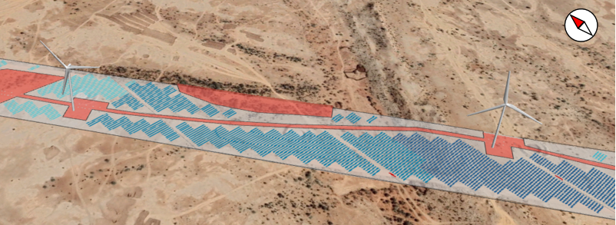
Least Cost of Energy Solar PV – Wind - BESS
Case 3 Continued – Interconnection Arrangement
Shading on Solar PV arrays
In Hybrid Solar Wind Power Plants Shading is an important aspect during the siting.
The diagram below shows the configuration of installation.
The results of simplified analysis shows that less than 1% per month is lost to shading with a total sum of 2% per annum.

Slide 28
Way Forward:
Land:
BOR to be approached for issuance of Allotment Order;
BOR will submit the Case to Cabinet for approval;
Land Lease Fee be Submitted by SREC
SREC to obtain Funds from SEHCL

Slide 29
Thankyou
Engr. Mehfooz Ahmed Kazi

